Slide 1

ECE411 - Practicum T05 – Electronic Compass
Cody Gabriel
Benjamin Huntsman
John Maseda
Michael Walton

Slide 2
Needs
Land Navigation Human Calibration
Robot needs compass input
Project required for Practicum

Slide 3
Motivation
The value is in the USB interface for Robot
Alternative compass solutions are analog or phone based with the primary user being Human.
Provides something that was not accessible at relatively low cost before.

Slide 4
Objective
Our objective is design, build, and test a working digital compass prototype.
The design will incorporate:
8-bit microcontroller as a processing unit
magnetometer as an input sensor
an LCD display as an output

Slide 5
Alternatives
There are no COTS alternatives for the Robotic compass that are financially feasible.
Many modern alternatives exist for basic land navigation.
Analog compass
Smartphone apps
Handheld GPS devices

Slide 6
Requirements (Course)
The project must:
Have one or more inputs or sensors
Have one or more outputs or transducers
Have one or more processing module
Use a 2-layer PCB
Use components that can be hand soldered or easily soldered in a crude reflow oven

Slide 7
Requirements (Engineering)
The system should:
Be accurate to within 5° of true orientation
Have a switch to power on the device and be ready within a short period of time
Display on a LCD a heading either with a compass face or with letters (i.e. “NNW”) as well as a numerical value in degrees
Be prepared for software updates
[backlight??]

Slide 8
Approach: Project Selection
A list of four possible projects were considered:
Electronic Compass
Bicycle brake light/blinker system
Ironman Repulsor Weapon
Homemade oscilloscope

Slide 9
Approach: Initial Design
Major components selection ($$)
μC: ATmega32u4
Magnetometer/Accelerometer: LSM303DLH
LCD: Nokia 5110
PMIC: LTC4067
Research major components; understanding setup and operation
Order development boards from SparkFun for initial prototyping
Defining project requirements

Slide 10
Approach: Schematic, Layout, & IDE
Application notes for the major components were considered
Decided to only implement μC and PMIC on manufactured board; LCD and magnetometer dev-boards connected via header pins
EAGLE CAD software used for schematic and layout
[IDE used for coding]

Slide 11
Approach: Construction
The board layout was sent to OSH Park for fabrication using their design rules
Two of our major components, Atmega32u4 and LTC4067 came in packages that were not hand solder-able
The ATmega32u4 chip that we used came in a QFN package, and the LTC4067 was in a DFN package
Due to the components that could not be soldered by hand, the reflow oven in the EPL was used for construction

Slide 12
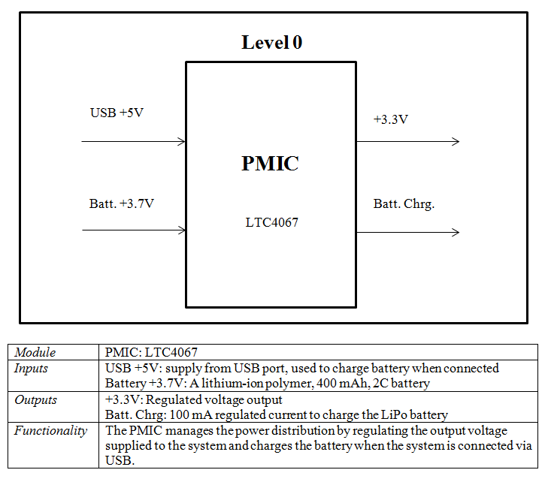
Design: Power Management

Slide 13
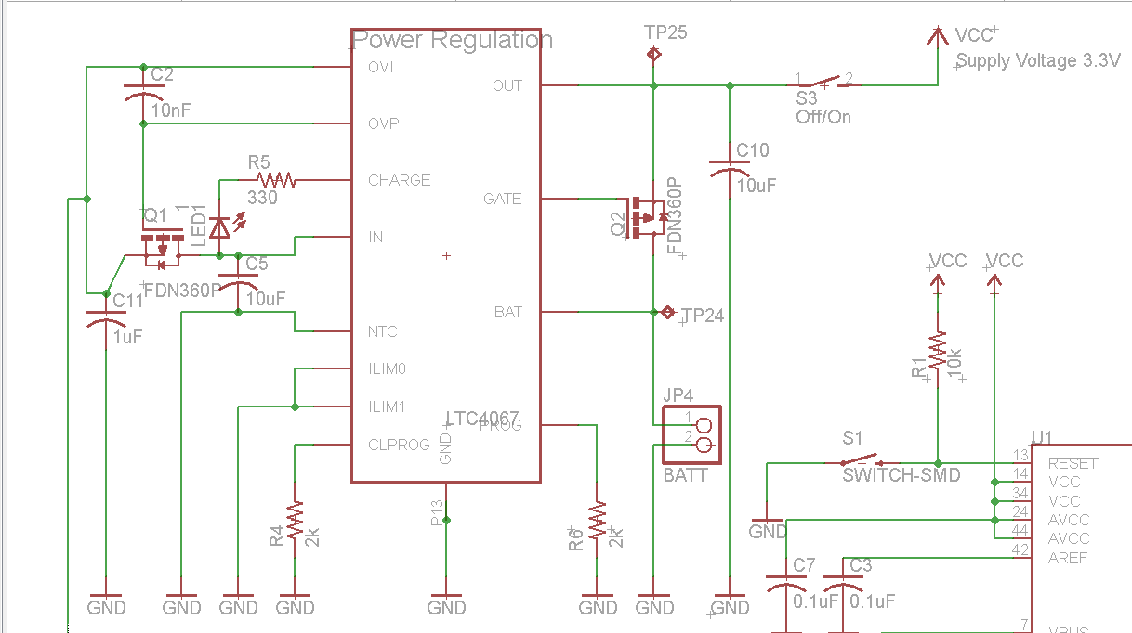
Design: Power Management
[I may remove this slide later]

Slide 14
Design: Microcontroller
[add uC design diagram from HW once signals are more descriptive]

Slide 15
Design: Coding

Slide 16
Implementation
Board Layout: Eagle CAD Implemented
Pin 1 Convention top left
Caps as close as possible to ICs
μC centered for space management
Large power lines
Signal Lines Rx, Tx same length
LCD header centric
Test points and vias for all GPIOs (modifiable)
Magnetometer headers “Isolated” from noise

Slide 17
IP/Prior Work
We utilized the LCD and Magnetometer Development Boards.
Implementing these COTS Items cost an extra $10 per board, and added design, and implementation constraints.
Saving the time and effort of integrating these components.

Slide 18
Testing

Slide 19
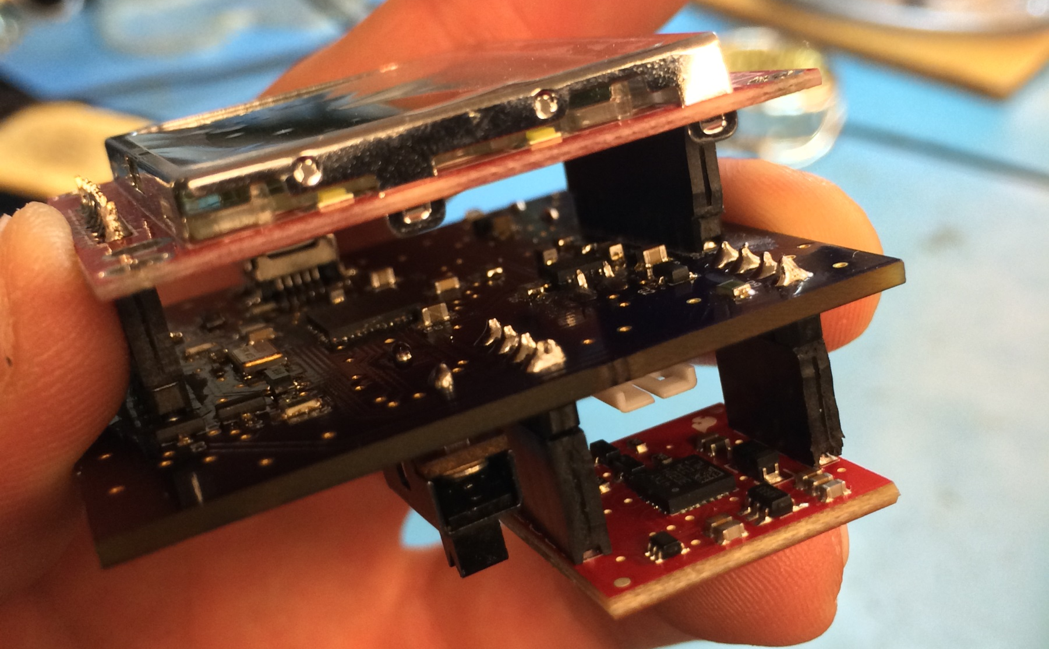
Results

Slide 20
Ben’s Contributions

Slide 21
Michael’s Contributions

Slide 22
John’s Contributions
Schematic Design: Initial layout, editing, revising, updating.
Layout: stack design, part placement, layer design, routing, organization, revising updating.
Implementation: oven soldering, hand soldering, assembly
Test:
Documentation:

Slide 23
Cody’s Contributions
Initial Design: PMIC selection
Schematic: adhered to application notes for USB battery charging and C busses, designed GPIO enabled transistor switches, minor parts selection
Parts order and tracking
Major contributor to group homework assignments and documentation
Testing:

Slide 24
Ben’s Lessons Learned

Slide 25
Michael’s Lessons Learned

Slide 26
John’s Lessons Learned
Getting started early sets up the team for success.
Problems will occur preparing for them is possible.
When it is not possible to prepare for a problem grace is required to deal with it.
Eagle Cad is a good free program.
Bulk board orders are cheaper
The EPL is an awesome but very small place to be

Slide 27
Cody’s Lessons Learned
Professional grade design and construction
Constant communication is key to success
Step up when the team needs you to
Verify all parts are ordered more than once
Don’t be complacent!

